Slide 1
Linux Administration
Week 1
Introduction

Slide 2

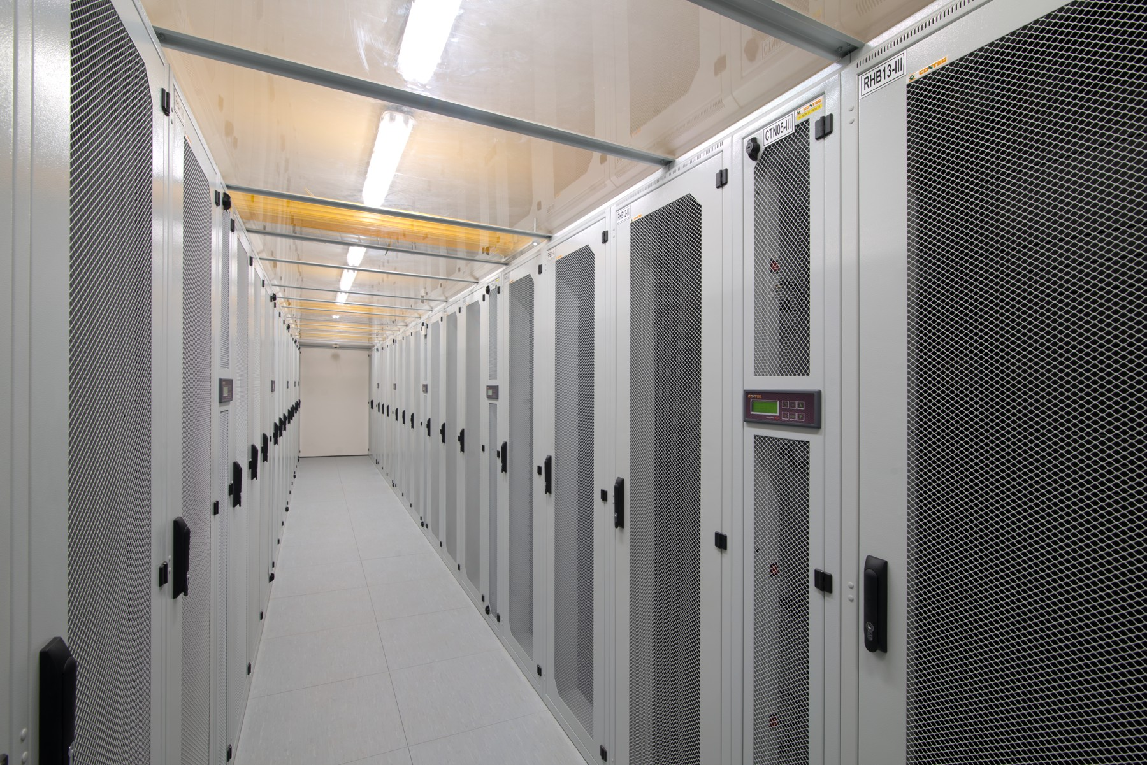
What is a server?
A computer or computer program which manages access to a centralized resource or service in a network.
-Oxford English Dictionary

Slide 3
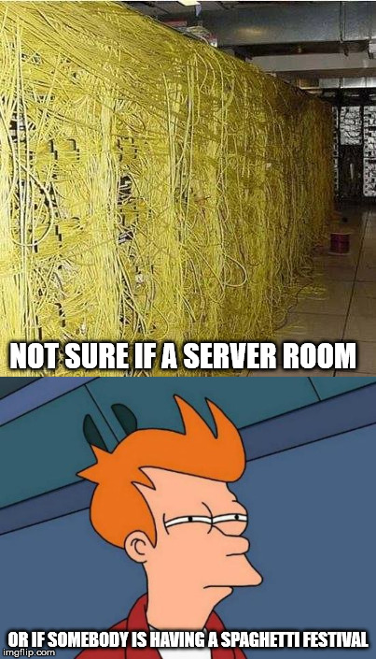
Why do we have servers?
Can serve multiple clients
More powerful than traditional client computers
Can have different functionalities (I.e. Web vs DHCP)
Can share resources or services

Slide 4
How is a server different then a regular computer?
More Powerful
Not always enabled with a GUI
May not have a monitor attached
Likely to Have Networking capabilities and SSH
Must be more fault tolerant
Must have more reliability
Mission Critical systems run on servers or Mainframes.
Often lives in a Rack, maybe even a data center
Must have more powerful cooling

Slide 5
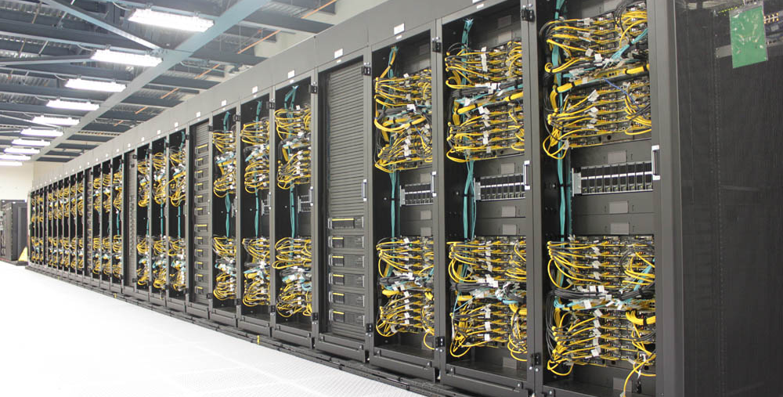
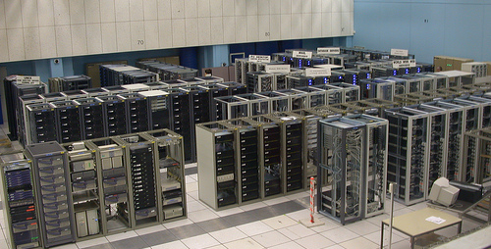
Clusters
Servers can also reside in a cluster or server farm
Modern data centers are often clusters

Slide 6
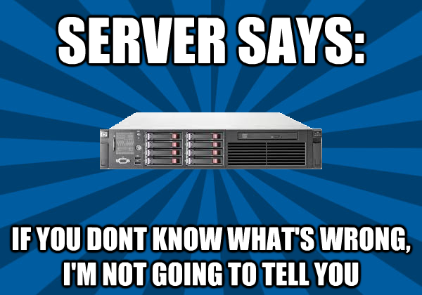
Different kinds of dedicated servers (more detail later in term)
Email
Web
DNS
DHCP

Slide 7
Different kinds of servers
Testing (Automated or not automated)
Staging (Resembles production environment as close as possible)
Production (Live server *Here be Dragons* for dev)
Application (Host web apps)
Database (Database hosting)
File (File hosting)
Proxy (Intermediary between clients and other servers)
Game (MMORPG)
Print (Share a printer)
Catalog (such as directory or name servers)
Communications (telecommunications and Endpoints)
Media (Plex)

Slide 8
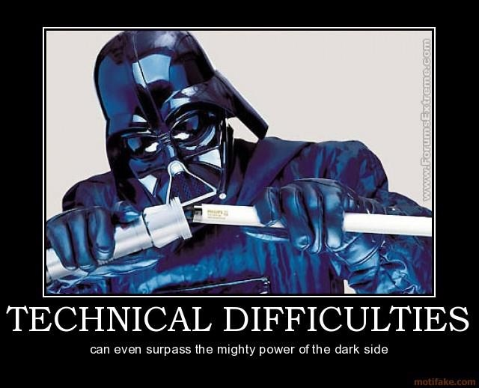
Most popular server Operating Systems
Nginix
Red Hat/CentOS/Rocky
Ubuntu Server
Debian

Slide 9
Single vs Multi Server architecture
Single task can do 1 thing at once
Pros: Simplicity, easier configuration, works on low powered servers
Cons: Scaling, upgrades and speed
Multi task uses time sharing to do multiple things
Pros: specialization can lead to efficiency and optimization, scaling is easier
Cons: Set up can be more challenging. More configs to worry about
Multi User systems
Distributed Operating Systems

Slide 10
Virtual vs Physical Servers
Virtual servers
Easier to manage remotely
Easier to spin up another VM
Easier to sandbox each server away from each other
Needs more specialized skills beyond server management
More portable
Easier to scale
Easier to do Disaster recovery and backups
More fault tolerant
Physical Servers
Harder to manage remotely
May be lower Power/resources
Can have security issues with sandboxing and access
Can get expensive

Slide 11
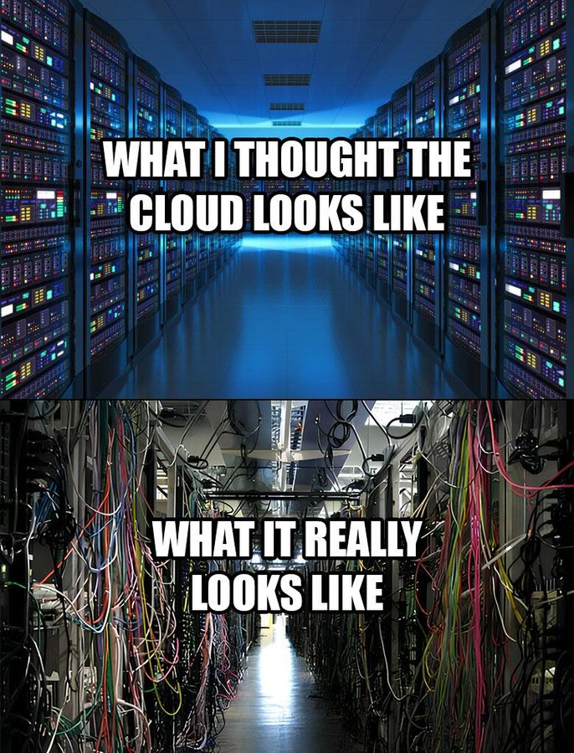
Cloud Services
Cloud Server Providers
AWS
Azure
Google Cloud Platform
Cloud server software for large company to set up their own in house cloud servers (not the same as cloud storage!)
VMWare
Data centers
Can pay based on usage of bandwidth, or storage space
All of these might need to follow protocols/regulations based on industry (for example, HIPAA certified)

